Slide 1
sInvestigator
Teaching Critical Thinking Skills in Science
Building Information Literacy
Using sInvestigator to Evaluate the Credibility of Internet Sources
Terrie Galanti
Nancy Holincheck
Gheorghe Tecuci
Mihai Boicu
Dorin Marcu

Slide 2
Theoretical Framework
Information Literacy
Ability to assess “authority, relevance, currency, quality, coverage, and objectivity” of online evidence
A construct within a skills-based framework for digital literacy
Photo-visual literacy
Reproduction literacy
Branching literacy
Information literacy
Socio-emotional literacy
Real-time thinking
Fieldhouse & Nicholas, 2008
Eshet-Alkalai & Chajut, 2009
Notes:
Broadly defined
knowledge and application of technological, cognitive, and sociological skills in the use of electronic information
“mastering ideas, not keystrokes” (Gilster, 1997)
Interacting w/environment 2. Creating authentic work by manipulating 3. nonn-linear navigation 4. evaluate for bias 5. effective communication 6. processing large amounts of information

Slide 3
Theoretical Framework
Information Literacy and Scientific Inquiry
Prior research on interventions to build information literacy in science education
1. Critical thinking modules for high-school students
Credibility, accuracy of content, reasonableness, and support
2. Prompts and scaffolds for thoughtful evaluation of sources and position-taking for undergraduate non-science majors
3. Building content knowledge through scientific inquiry
Source, evidence, explanation, and knowledge (SEEK) instruction
Brem, Weems, & Russell, 2001
Halverson, Siegel, & Freyermouth, 2010
Wiley et al., 2009
Notes:
NGSS – scientific inquiry within the nature of science
pursuit of logical thinking, precision, open-mindedness, objectivity, skepticism
Students do not critically consider the information they find on the Internet – reliance on surface markers

Slide 4
sInvestigator
Critical Thinking about Scientific Information
Computational tool to build argumentation with supporting evidentiary reasoning
Students generate hypotheses based on evidence
Students evaluate credibility and relevance of associated evidence which may favors or disfavor hypotheses
sInvestigator calculates the “inferential force” of evidence and hypotheses in response to scientific inquiry
Student collaborate to understand, critique, and debate scientific evidence

Slide 5
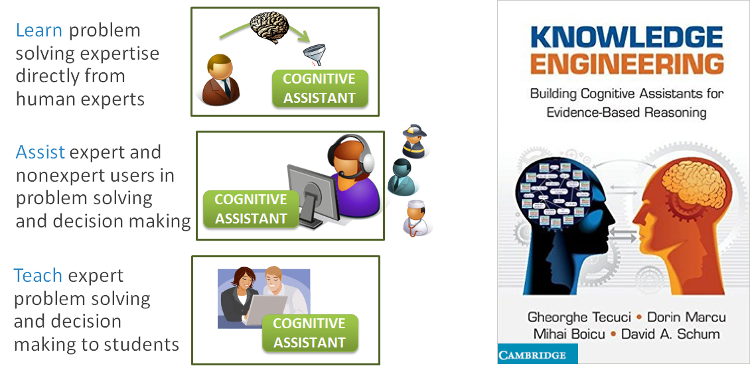
Basis for sInvestigator

Slide 6
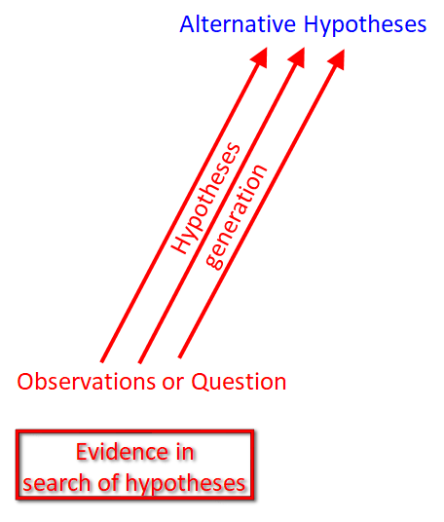
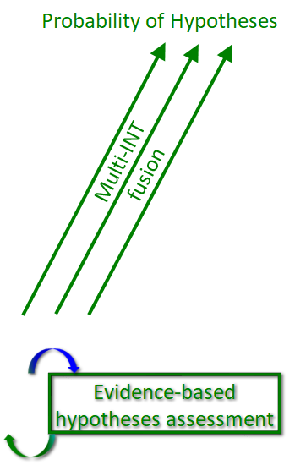
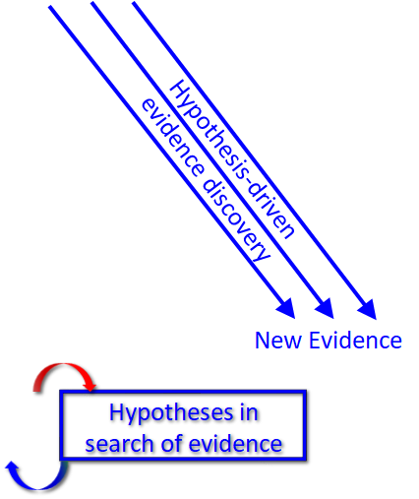
Computational Theory of Intelligence Analysis

Slide 7
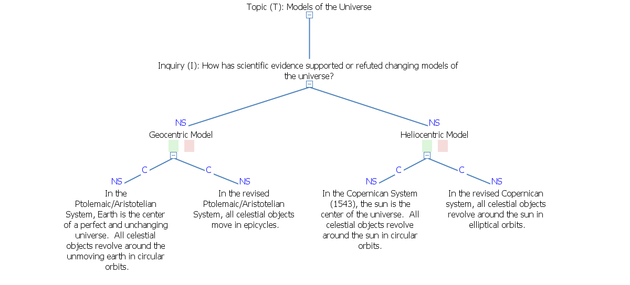
Teachers or students develop a series of hypotheses and sub-hypotheses to conduct a scientific inquiry.
Notes:
Do we want screen shots? Not very readable

Slide 8
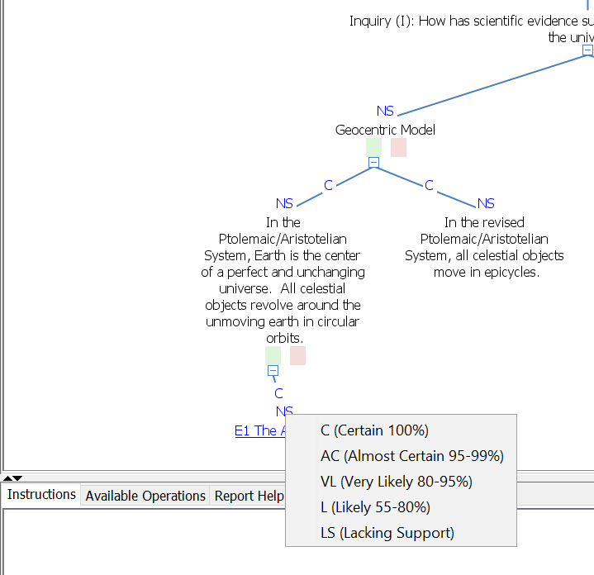
Students assign items of online evidence to hypotheses and evaluate relevance and credibility.
Relevance
Credibility

Slide 9
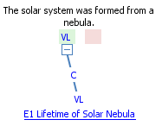
sInvestigator calculates the likelihood that hypotheses are true based upon assigned evidence and ratings.
sInvestigator calculates the likelihood that hypotheses are true based upon assigned evidence and ratings
Relevance
Credibility

Slide 10
Project Objective and Approach
Objective: Help students develop critical thinking skills within inquiry based-science instruction
Fall 2016: Identified initial focus as evidence evaluation, developed files with evidence & argumentation
Spring 2017: Initial implementation in undergraduate classroom, focused on evidence evaluation
Fall 2017: Focus on evidence evaluation student engagement with specific content knowledge
Spring 2018: Continue student evaluation of evidence; Scaffold student development of argumentation
Fall 2018-Spring 2019: Expand use of sInvestigator in additional courses with treatment & control conditions

Slide 11
Research Questions
How does sInvestigator help students develop information literacy?
In what ways do students evaluate academic sources differently after using sInvestigator?
Are student’s learning content in an inquiry setting?

Slide 12
Methods
Spring and Fall 2017– History of Science
32-35 undergraduate honors students
Two classroom experiences with sInvestigator
Brief lectures by professor
Copernican Revolution
Evolution
Initial argumentation and evidence provided by professor
Collabarative search for additional evidence supporting or refuting the given hypotheses
Notes:
Groups of 3-4

Slide 13
Measures
Pre & post measures
Evaluation of Scientific Evidence (Current Topics)
Content Knowledge (Historical Topics)
Electronic class “exit tickets”
Ranking credibility of familiar evidence
Assessing credibility of evidence examined during class using probabilistic scale
Observations of students during classes
Group audio recordings & video recordings of class

Slide 14
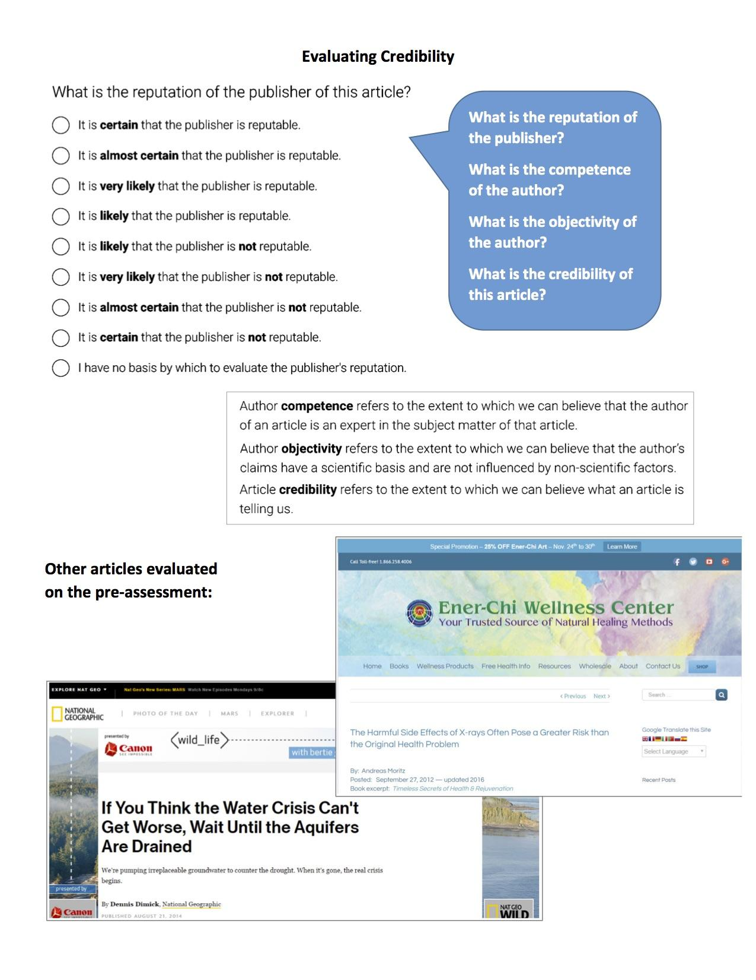
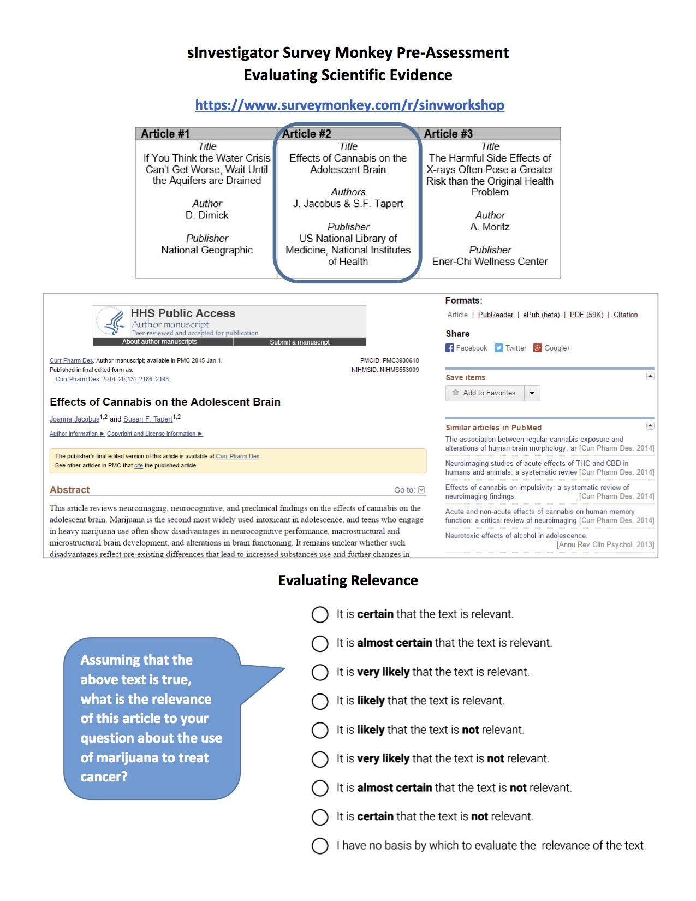
Evaluating Scientific Evidence Topic of Current Interest
How do students use probabilistic reasoning to evaluate credibility and relevance of three items of online scientific evidence?
Administered at beginning and end of semester
Adapted from Test of Scientific Literacy Skills (TOSLS) (Gormally, Brickman, & Lutz, 2012)

Slide 15
Findings - Spring 2017 Course
•Focus on Peer-reviewed academic journals:
–What is the reputation of the publisher of this article?
•Percentage of students rating “It is certain that the publisher is reputable” increased from 41% to 63%
–What is the credibility of this article?
•Percentage of students rating “It is certain that the article is credible” increased from 31% to 48%
Conclusion: After using sInvestigator as part of a college science course, more students were able to identify peer-reviewed academic sources as certainly reputable and certainly credible

Slide 16
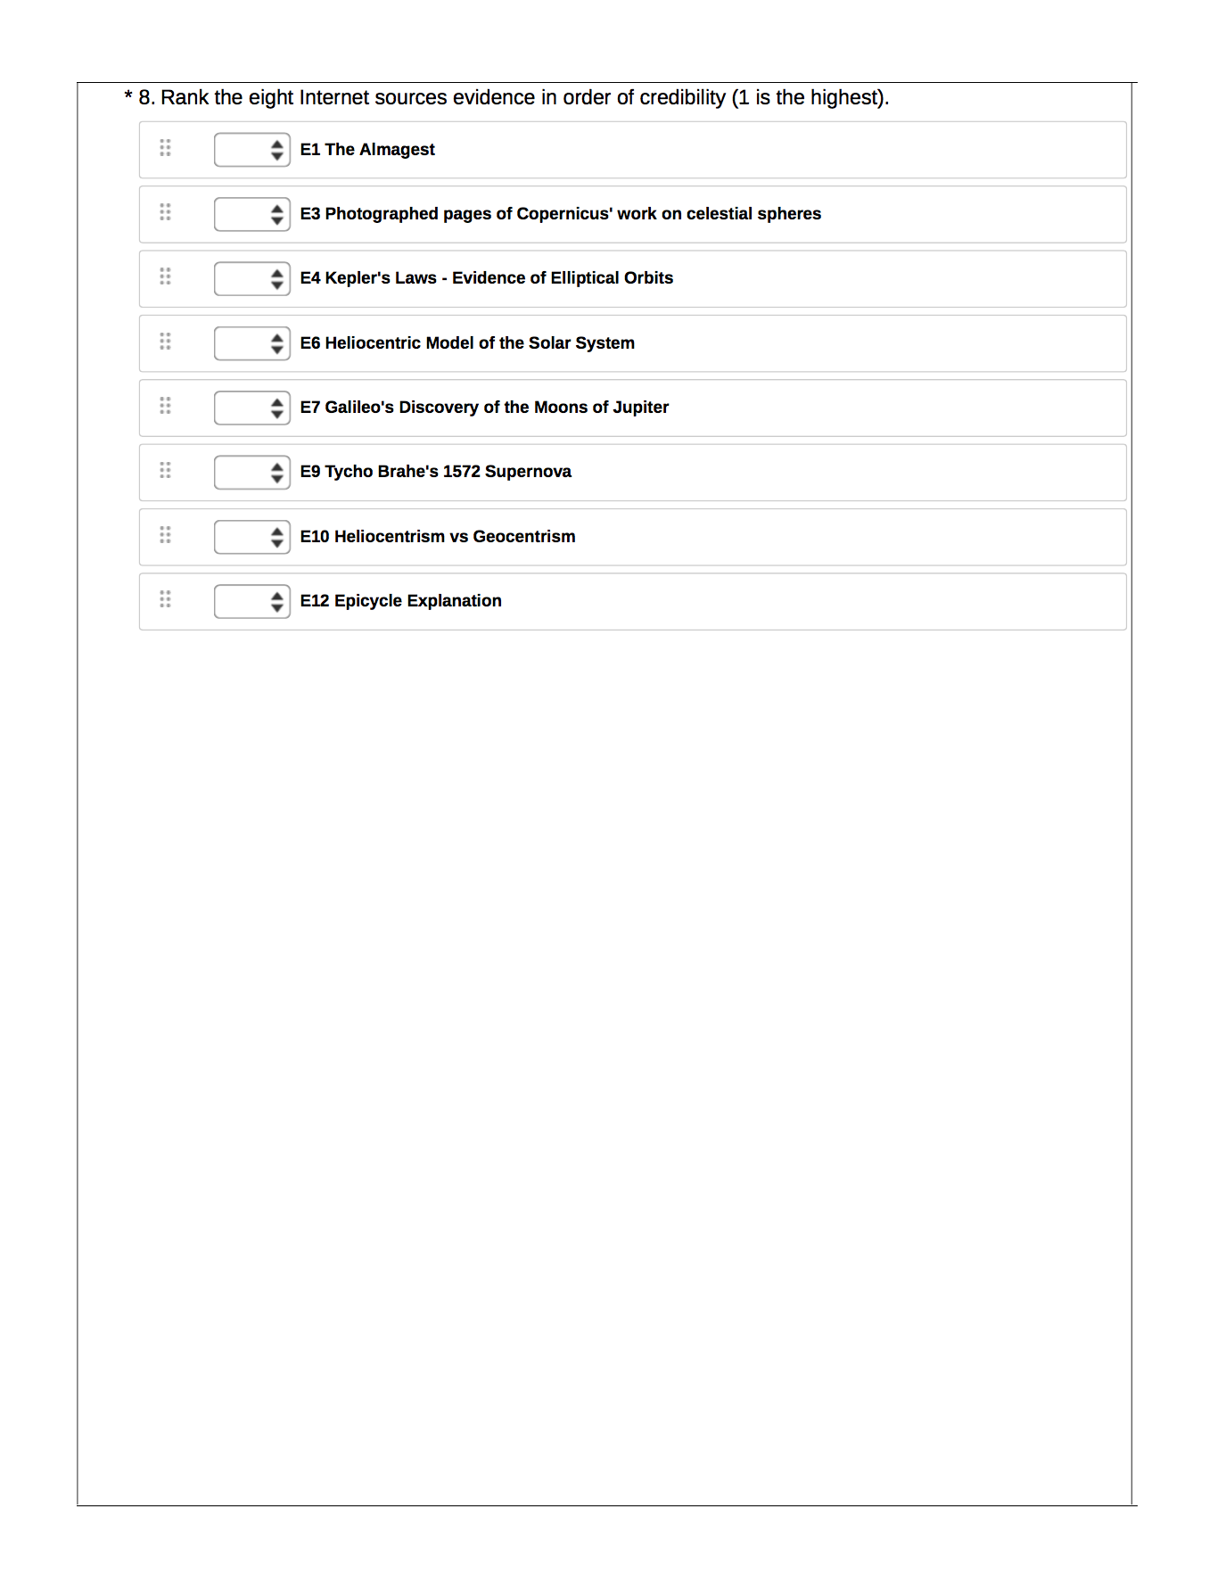
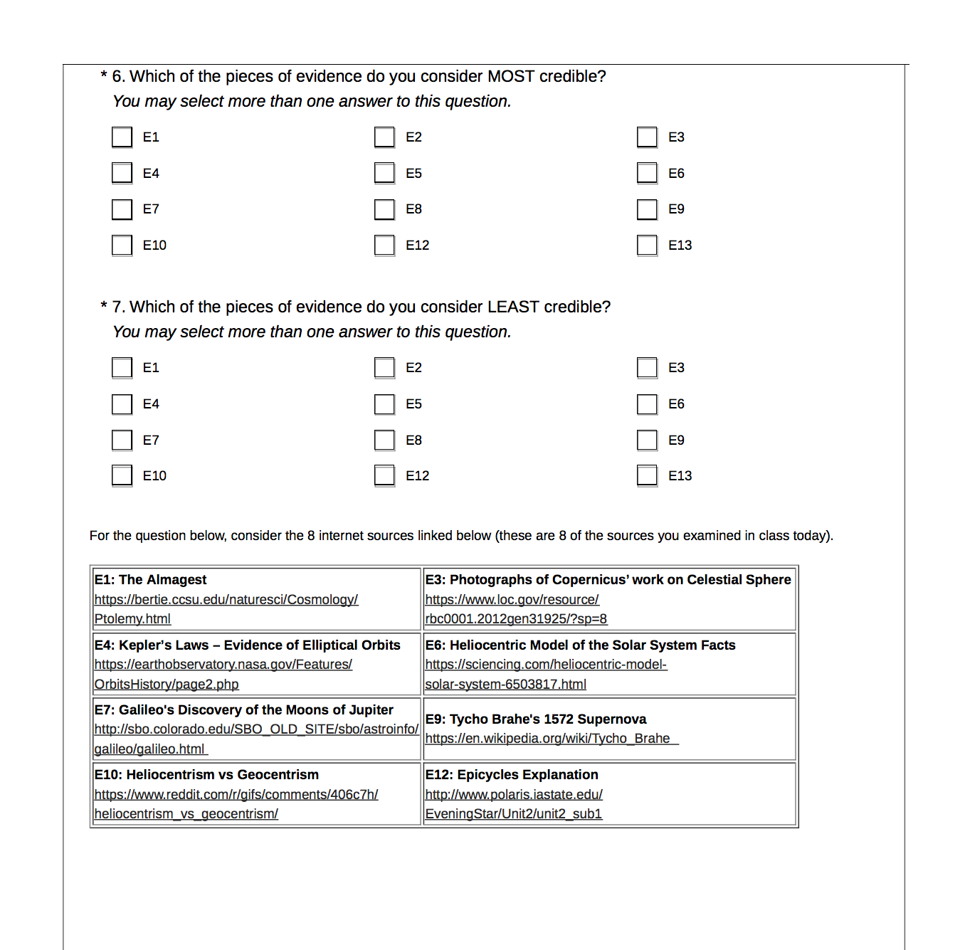
Evaluating Scientific Evidence Historical Topics
Students completed an online exit ticket based on evidence they had evaluated using sInvestigator during class
Categorized items of evidence as most or least credible
Ranked 8 items of evidence by credibility
Notes:
Goal - make a more explicit connection between information literacy and course content knowledge

Slide 17
Findings - Fall 2017 Ranking Credibility of 8 Items of Historical Evidence Copernican Revolution
Student ranking of two primary (original) sources
Only 13 of 27 students ranked photos of Copernicus’ work in Library of Congress as highly credible (e.g. rank of 1 or 2)
18 of 27 students ranked “The Almagest” as highly credible
Student ranking of two unreliable sources
25 of 27 students ranked the Wikipedia entry as unreliable or least credible (e.g. rank of 7 or 8 out of 8)
21 of 27 students ranked the Reddit thread a 7 or 8 out of 8
Highest Mean Ranking
NASA Earth Observatory (.gov website)
Logo displayed prominently at top of page
Notes:
Categorizations derived from Wiley et al. (2009)
E1, E3 - Highly credible – Almagest, Photos of Copernicus work
E4, E7, E12, E6 – Reliable, reputable
E9, E10 – unreliable – Wikipedia, Reddit

Slide 18
Findings - Fall 2017 Ranking Credibility of 8 Items of Historical Evidence Copernican Revolution
Many students did not trust the text or photos of primary sources published online; students may be more inclined to trust new information or familiar sources
Almost all students appropriately identified the Reddit and Wikipedia sites as having low credibility
The mean ratings of the two educational institution websites were equal and exceeded only by the ratings of the two primary sources and the governmental website
Notes:
Categorizations derived from Wiley et al. (2009)
E1, E3 - Highly credible – Almagest, Photos of Copernicus work
E4, E7, E12, E6 – Reliable, reputable
E9, E10 – unreliable – Wikipedia, Reddit

Slide 19
Findings - Fall 2017 Ranking Credibility of 8 Items of Historical Evidence Evolution
Most reliable sources
21 of 26 students ranked educational institution website as highly credible
Only 13 of 26 students ranked peer-reviewed journal article as highly credible
Least reliable sources
20 of 26 students ranked the Wikipedia entry as 7 or 8
23 of 26 students ranked the Reddit thread as 7 or 8
Highest Mean Ranking
PBS Library (.org website)
Notes:
Categorizations derived from Wiley et al. (2009)
E1, E11 - Highly credible – educational, peer reviewed
E2, E7, E9 – pbs, science magazine, New Yorker,
E4 – moderately reliable – science blog
E10, E13 – Wikipedia, Reddit

Slide 20
Findings - Fall 2017 Ranking Credibility of 8 Items of Historical Evidence Evolution
Students rated magazines (Science and New Yorker) more highly than a science blog
Almost all students appropriately identified the Reddit and Wikipedia sites as having low credibility
Students rated the pbs.org science tutorial as being more credible than a peer-referenced journal article

Slide 21
Findings - Spring 2017 Current Sources
Students were asked to select one of three current sources that they would most likely use as a reference
Pretest:
Consumer Reports, British Institute of Radiology, The EnerChi Wellness Center
25 of 27 students selected British Institute of Radiology
Posttest:
The Sports Journal, International Journal of Sports Nutrition, TeamSnap
21 of 28 students selected the International Journal of Sports Nutrition
The majority of students selected the most credible journal in a more nuanced list than the Fall 2017 instrument

Slide 22
Content Measures
There was a statistically significant increase in students’ scores on the Copernican Revolution content measure (Pre M=5.50, SD=2.57; post M=8.96, SD=1.31), t(25)=-6.88, p <.001)
Post test data – negatively skewed (did not meet assumption of normality)
Non-parametric methods (Wilcoxon signed rank test) were considered but did not meet assumption of symmetry of results above and below mean
25 of 26 students improved their scores
There was a statistically significant increase in students’ scores on the Evolution content measure
(Pre M=6.34, SD=1.58; post M=8.30, SD=1.31), t(23)=-5.51, p < .001)
20 of 24 students improved their scores
Notes:
Copernican Revolution paired-test – Cohen’s d = 1.70
Evolution paired-test – eliminated Question 4 (attractive distractor)

Slide 23
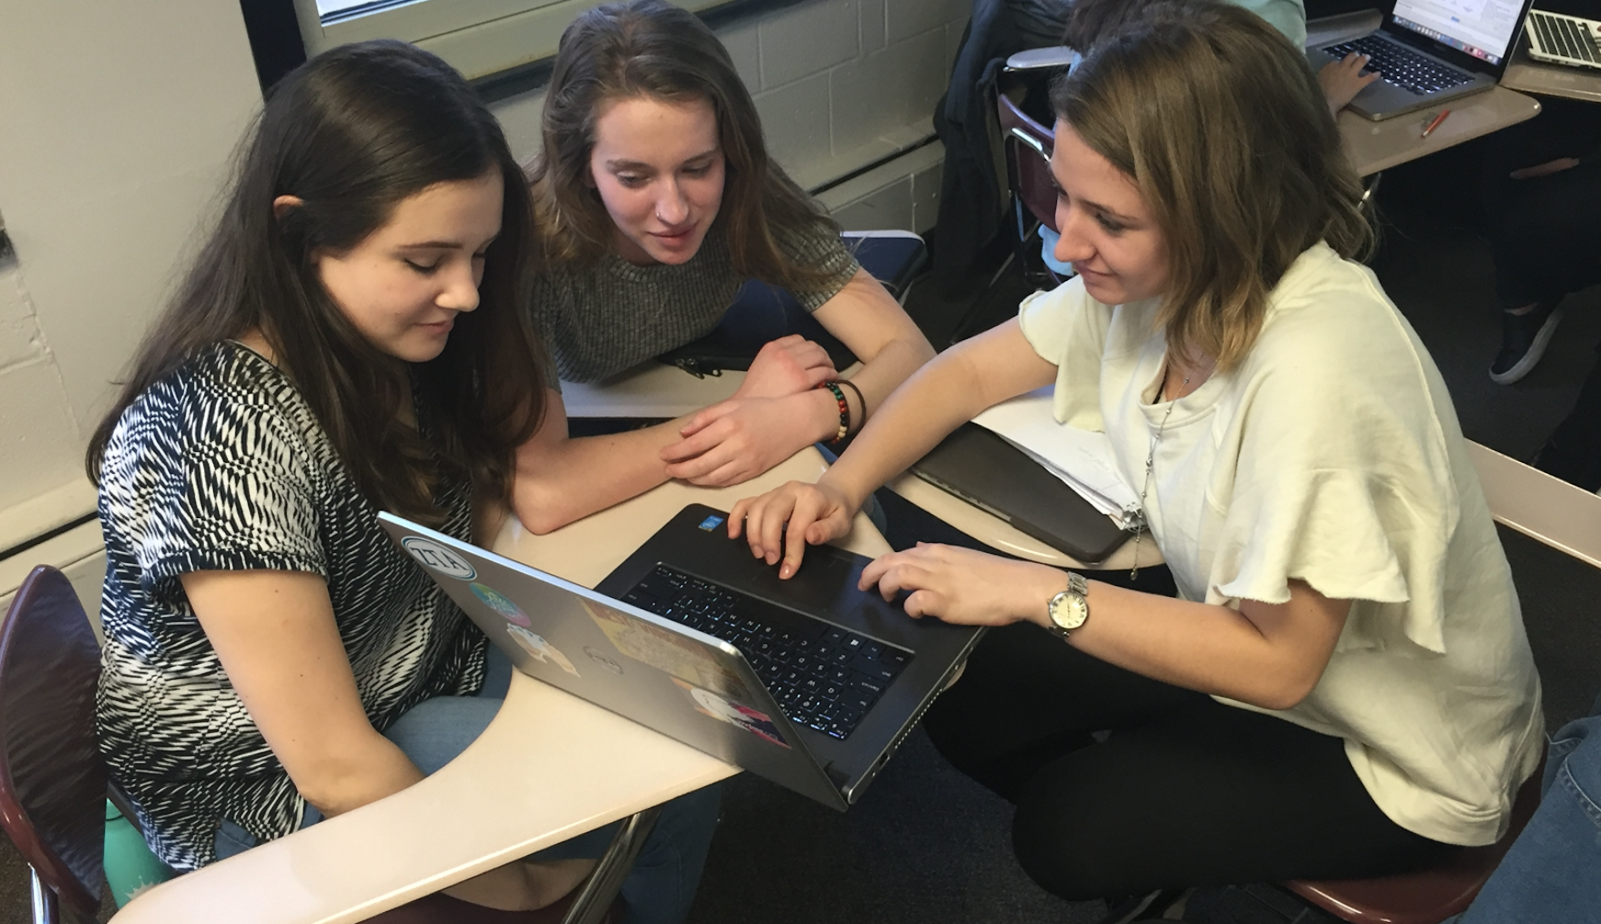
Qualitative Findings
Use of sInvestigator in small groups promoted collaborative conversations and debate
Students were engaged in discussion about science content while working in groups
Although some time was spent off task, while using sInvestigator students regularly returned to discussion of content

Slide 24
Students voices on using sInvestigator as an Inquiry tool
“It forced me to read up on articles related to course topics which sort of indirectly immerses you into the topic.”
“Collaboration is key!”
“I now relate to science in terms of credibility, whether facts are backed up with a credible source or not.”
“I feel like it deepened our knowledge but added a lot of extra work.”

Slide 25
Additional Findings
Students are tech-savvy and require purposeful scaffolding rather than direct step-by-step instruction
“They were surprisingly good at picking up the different operations of the the tools” - Graduate Assistant
The software scaffolds and supports student thinking. Students relied on the sInvestigator guide that was added to the system to support evaluation of credibility of an article
sInvestigator software was added to support the lesson introducing evidence evaluation, but students continued to use it throughout the course

Slide 26
Conclusions, Limitations, Implications
sInvestigator as a computational tool promotes information literacy
Probabilistic ratings of credibility and relevance to hypotheses promote thoughtfulness and debate
Results with undergraduate honors students have limited generalizability
Students were required to take a research methods course upon program entry
Students may have had deeper prior knowledge of scientific content
Student gains in content knowledge are reassuring, especially for instructors who are transitioning to student-centered scientific inquiry
Notes:
Students attentive to web address extensions

Slide 27
Continuing Work
Students are leveraging information literacy as they respond to their own futuristic inquiries
Examples
What will airport architecture and technological infrastructure look like in the future?
How can the SpaceX BFR be used for future space transportation?
How will the development and integration of autonomous cars affect safety and privacy in US cities?

Slide 28
For more information about sInvestigator...
https://sites.google.com/site/sinvestigatorgmu/

Slide 29
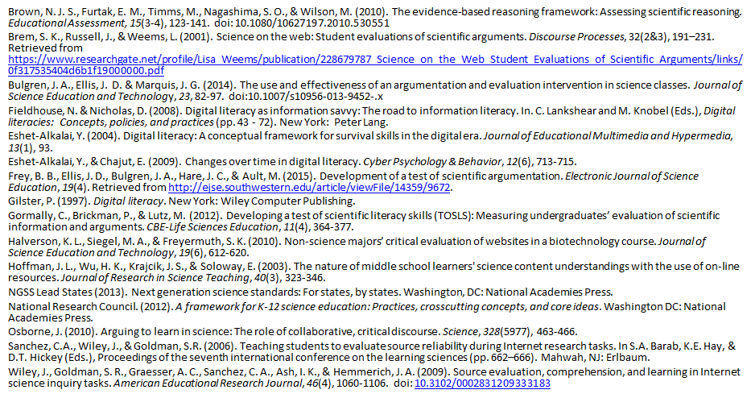
References

