Slide 1

Teaching Critical Thinking Skills in Science with sInvestigator:
Project Introduction
Improving Undergraduate STEM Education: Education and Human Resources (IUSE: EHR)
Volgenau School of Engineering (Gheorghe Tecuci, Mihai Boicu, Dorin Marcu)
College of Science (James Trefil)
College of Education & Human Development (Nancy Holincheck, Terrie Galanti)

Slide 2
Overview
Project Objective and Approach
Basis for sInvestigator
Scientific Inquiry through Evidence-based Reasoning
Evidence-based Reasoning Everywhere
Discussion

Slide 3
Project Objective and Approach
Main Objective: Help students develop critical thinking skills in addressing scientific problems
Approach: Students, working in teams, are guided through a systematic process of solving a complex problem by using the sInvestigator intelligent computer system
  Generate competing hypotheses from their observations of events in nature
  Use their hypotheses to generate new lines of inquiry and discover new evidence
  Test their hypotheses based on the evidence they are discovering, to determine the most likely hypothesis
  Present and debate their results
Dissemination Goal: To all STEM disciplines, for both undergraduate and K-12 students

Slide 4
Overview
Project Objective and Approach
Basis for sInvestigator
Scientific Inquiry through Evidence-based Reasoning
Evidence-based Reasoning Everywhere
Discussion

Slide 5
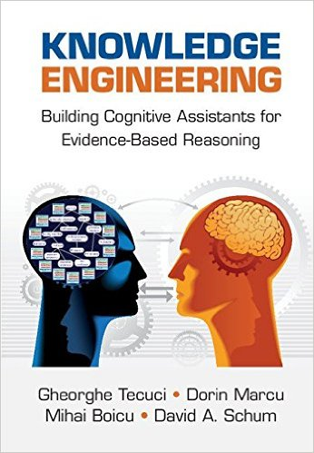






Disciple Theory, Methodology, and Tools for the Development of Cognitive Assistants
  Learn problem solving expertise directly from human experts
COGNITIVE
ASSISTANT
  Assist expert and nonexpert users in problem solving
  and decision making
COGNITIVE
ASSISTANT
  Teach expert problem solving and decision making to students
COGNITIVE
ASSISTANT

Slide 6
Computational Theory of Intelligence Analysis
Alternative Hypotheses
Probability of Hypotheses
The purpose of intelligence analysis is to answer questions arising in the decision-making process by analyzing evidence about the world.
Multi-INT
Hypotheses
Hypothesis-driven
fusion
generation
evidence discovery
What is the probability that Al Qaeda has nuclear weapons?
What is the probability that the United States will be a world leader in non-conventional energy sources within the next decade?
Observations or Question
New Evidence
Evidence in
search of hypotheses
Hypotheses in
search of evidence
Evidence-based hypotheses assessment

Slide 7

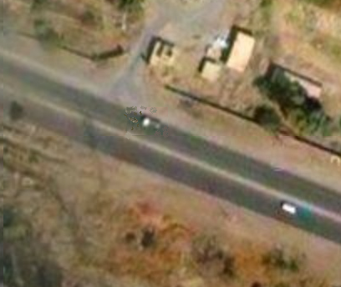
ambush threat
deceptive threat
ambush preparation
traffic disruption
traffic deviation
road block
road repair
not
road work
road work
E₁: Evidence of road work at Al Batha junction at 1:17am
What hypotheses would explain this observation?
Big
Data

Slide 8
Assuming that this hypothesis is true, what other things should be observable?
Ambush threat at Al Batha highway junction around 1:17am.
&
good
location
ambush preparation
&
&
deployment of terrorists
road
block
people
move
to cover
&
route used
by U.S. forces
ambush
cover
people descended from vehicle
vehicle departed from terrorist facility
Search for evidence that the Al Batha highway junction is on a route used by the U.S. forces.
Search for evidence that there is ambush cover near the Al Batha highway junction.
Search for evidence that people descended at the Al Batha highway junction from a vehicle short before 1:17am.
Search for evidence that the vehicle that drove the people to the Al Batha highway junction short before 1:17am, departed from a terrorist facility.

Slide 9
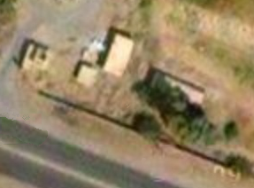
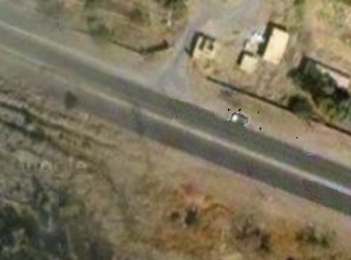
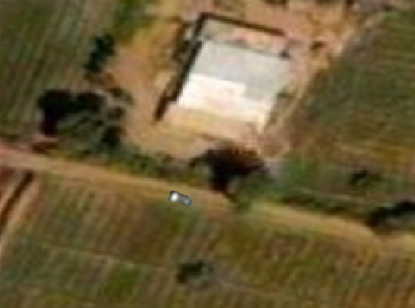
Assuming that this hypothesis is true, what other things should be observable?
Ambush threat at Al Batha highway junction around 1:17am.
&
good
location
ambush preparation
&
&
deployment of terrorists
road
block
people
move
to cover
&
route used
by U.S. forces
ambush
cover
people descended from vehicle
vehicle departed from terrorist facility
E₅: USFC confirms route
E₂: Brushes, trees, and ruins
E₃: People get off pickup truck
E₆: Pickup truck leaves abandoned rice farm

Slide 10
Considering E₂, what is the probability of ambush cover?
Inferential force of evidence
almost certain
What is the probability that there is ambush cover?
ambush cover
Relevance or strength of inference
almost certain
How certain are we that if there are brushes, trees, and ruins, then there is ambush cover?
certain
C
certain
Credibility of evidence
almost certain
AC
E₂: Brushes, trees, and ruins
How certain are we that there are brushes, trees, and ruins?
very likely
VL
likely
L
no support
N
not set
NS

Slide 11
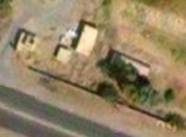
very likely
It is very likely that there is an ambush threat to the U.S. forces at the Al Batha junction.
ambush threat
&
almost certain
very likely
good location
ambush preparation
&
&
very likely
almost certain
certain
deployment of terrorists
road block
people move
to cover
certain
almost certain
&
route used
ambush cover
almost certain
very likely
people descended from vehicle
vehicle departed from terrorist facility
certain
almost certain
certain
very likely
certain
certain
almost certain
almost certain
E₂: AFC
confirms route
E₃: brushes, trees, and ruins
E₄: People get off pickup truck
E₅: Pickup truck leaves abandoned rice farm

Slide 12
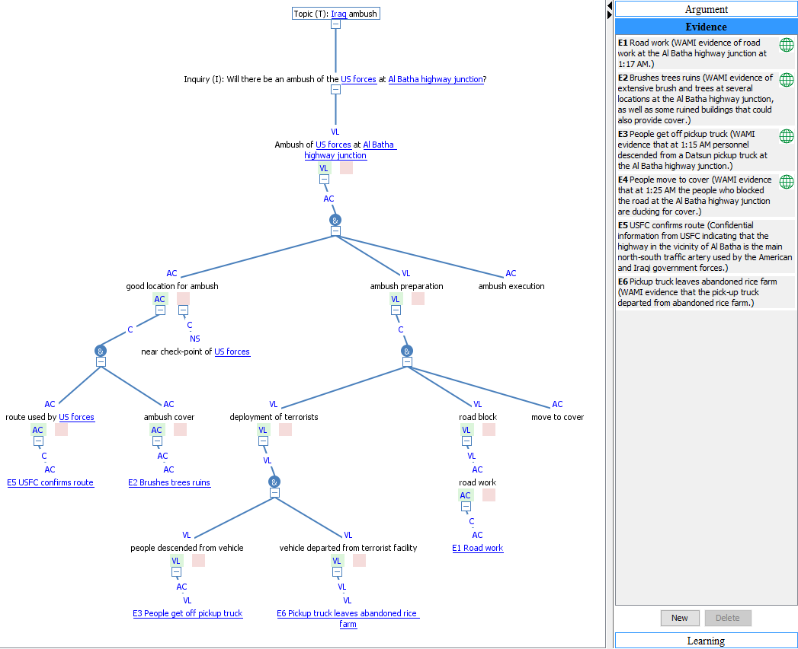
Ambush Demo:
Browsing an argumentation

Slide 13
Overview
Project Objective and Approach
Basis for sInvestigator
Scientific Inquiry through Evidence-based Reasoning
Evidence-based Reasoning Everywhere
Discussion

Slide 14
Scientific inquiry as discovery of evidence, hypotheses, and arguments
Possible Hypotheses
or Explanations
Probability of New
or Revised Theories
Assuming that H is true, what phenomena should be observable?
Evidence
Hypothesis-driven
fusion
Hypotheses
generation
evidence collection
What hypotheses would explain these observations?
Which is the evidence-based probability of each hypothesis?
Observations of Events in Nature
New Observable Phenomena
Evidence in search
of hypotheses
Hypotheses in
search of evidence
Evidence-based hypotheses assessment
Abduction
Deduction
Induction

Slide 15
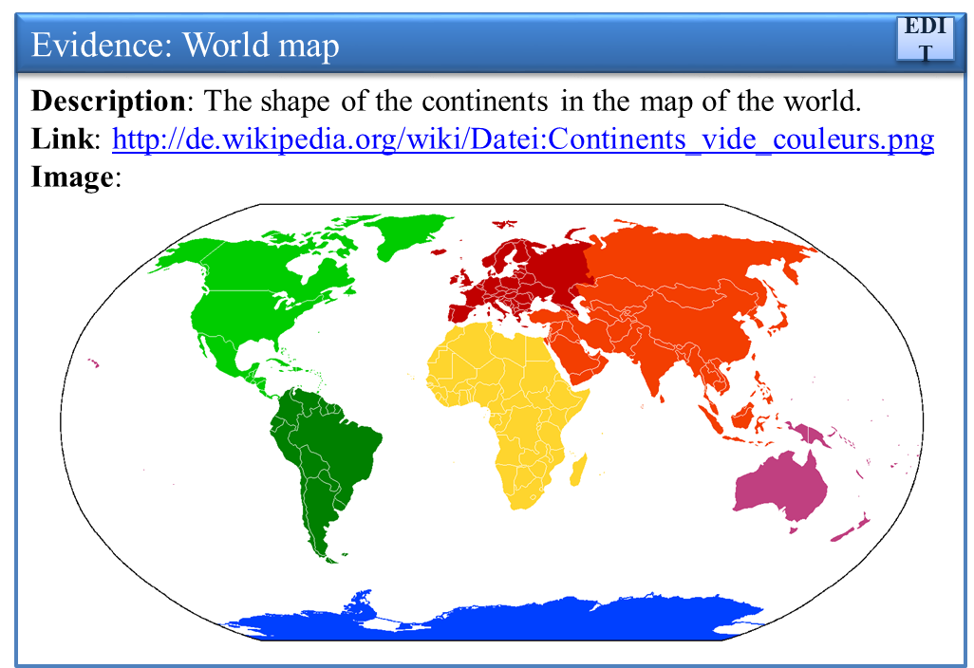
The continents are the land part of plates that make up the surface of the earth and the plates are continuously moving
The continents are continuously moving, but they are not on plates
The continents are continuously moving
The continents are no longer moving
The continents have been together once, broke, and moved apart
Nature randomly shaped the continents
The shapes of the continents match as in a puzzle
The shapes of the continents do not match
What hypotheses would explain this observation?
Boicu M., Tecuci G., Marcu D., Trefil J., Holincheck N., Inquiry-Based Teaching and Learning of Science with Cognitive Assistants, in Proceedings of the 2016 AAAI Fall Symposium “Cognitive Assistance in Government and Public Sector Applications,” pp.133-140, Arlington, VA, 17-19 November 2016, Technical Report FS-16-02, AAAI Press, Palo Alto, CA.

Slide 16
Assuming that this hypothesis is true, what other things should be observable?
The continents have been together once, broke, and moved apart over time
&
The continents have been together once
The continents broke and moved apart
…
The shapes of the continents match as in a puzzle
There are continuous fossil records across continents
There are fossils records suggesting different continent positions in the past
Search for evidence
Search for evidence
Search for evidence
E1: World map
E3: Identical fossils on both sides of the Atlantic
E4: Tropical fossils in Antarctica
E2: Similar shapes
of continental shelf

Slide 17
almost certain
What is the evidence-based probability of this hypothesis?
The continents have been together once, broke, and moved apart over time
&
almost certain
almost certain
The continents have been together once
The continents broke and moved apart
…
almost certain
very likely
very likely
The shapes of the continents match as in a puzzle
There are continuous fossil records across continents
There are fossils records suggesting different continent positions in the past
almost certain
certain
very likely
very likely
certain
almost certain
almost certain
certain
E1: World map
E2: Similar shapes
of continental shelf
E3: Identical fossils on both sides of the Atlantic
E4: Tropical fossils in Antarctica

Slide 18
Overview
Project Objective and Approach
Basis for sInvestigator
Scientific Inquiry through Evidence-based Reasoning
Evidence-based Reasoning Everywhere
Discussion

Slide 19
Evidence-Based Reasoning in Medicine
Possible illnesses
Probabilities of illnesses
Multi-INT
fusion
Hypotheses
Hypothesis-driven
generation
evidence discovery
Patient’s complaints
Test results
A doctor generates possible diagnoses (hypotheses) that would explain patient’s complaint. She then performs various medical tests that provide further evidence which is used in forming a final diagnosis for the patient.

Slide 20
Evidence-Based Reasoning in Forensics
Possible causes
Probabilities of causes
Multi-INT
fusion
Hypotheses
Hypothesis-driven
generation
evidence discovery
Observations at the site of incident
New evidence
Observations made at the site of an explosion in a power plant lead to the formulation of several possible causes. Analysis of each possible cause leads to the discovery of new evidence that eliminates or refines some of the causes, and may even suggest new ones. This cycle continues until enough evidence is found to determine the most likely cause.

Slide 21
Evidence-Based Reasoning in Law
Possible charges or complaints
Probabilities of causes
Multi-INT
fusion
Hypotheses
Hypothesis-driven
generation
evidence discovery
Observations during fact investigation
New evidence
In law, an attorney makes observations in a criminal case and seeks to generate hypotheses in the form of charges that seem possible in explaining these observations. Then, assuming that a charge is justified, attempts are made to deduce further evidence bearing on it. Finally, the obtained evidence is used to prove the charge

Slide 22
Evidence-Based Reasoning in Cybersecurity
Threat and nonthreat hypotheses
Probabilities of hypotheses
Multi-INT
fusion
Hypotheses
Hypothesis-driven
generation
evidence discovery
Evidence of suspicious activity
New evidence
In cybersecurity, a suspicious connection to our computer from an external computer triggers the automatic generation of alternative threat and nonthreat hypotheses. Each generated hypothesis is used to guide the collection of additional evidence, which is used to assess the probability of each hypothesis.
Meckl, S., Tecuci, G., Boicu, M., Marcu, D., Towards an Operational Semantic Theory of Cyber Defense Against Advanced Persistent Threats, in Proceedings of the 10th International Conference on Semantic Technologies for Intelligence, Defense, and Security – STIDS, Fairfax, VA, 18-20 November, 2015. http://lac.gmu.edu/publications/2015/APT-LAC.pdf

Slide 23
Project Activities (October 2016 – May 2017)
Development of sInvestigator Version 1
Incorporating Assessment of Internet Sources
Development of Help for Evidence Search, Representation, and Evaluation
Development of Lessons that Integrate the Use of sInvestigator into HNRS 353 Modern Scientific Revolutions
Development of Measures for Evaluation
Use of sInvestigator into the Classroom

Slide 24
Discussion

Slide 25
Acknowledgements
This research was partially sponsored by the National Science Foundation under DUE grant #1611742 and by George Mason University.
The views and conclusions contained in this document are those of the authors and should not be interpreted as necessarily representing the official policies or endorsements, either expressed or implied, of the U.S. Government.

