Slide 1
Evidence Evaluation
Year 1 Focus
(C) 2017 – George Mason University, Learning Agents Center
Laboratory for Collective Intelligence, Mihai Boicu
Argupedias – The Encyclopedia of Arguments for Crowd Problem Solving

Slide 2
Overview
Presentation Goals
Lesson Objective
Module Overview
Available Lessons with Instructions

Slide 3
Presentation Goals
Sample Lesson Plan
Introducing Evidence Analysis Principles
Introducing sInvestigator

Slide 4
Lesson Objectives
Understand how evidence is used to construct simple arguments
Understand the main credentials of scientific open source evidence
Analyze the main credentials of representative types of open source scientific evidence

Slide 5
Module Overview
Part 1: Introducing a simple argument
Part 2: Using Google search to support the argument
Part 3: Analyzing evidence features
Part 4: Using authoritative sources to support the argument

Slide 6
Formulating an Inquiry

Slide 7
Module Overview
Part 1: Introducing a simple argument
Part 2: Using Google search to support the argument
Part 3: Analyzing evidence features
Part 4: Using authoritative sources to support the argument

Slide 8
Searching for Evidence

Slide 9
Wikipedia Evidence

Slide 10
Defining the Evidence in sInvestigator

Slide 11
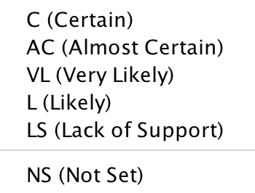
Associating the Evidence in sInvestigator
RELEVANCE
CREDIBILITY

Slide 12
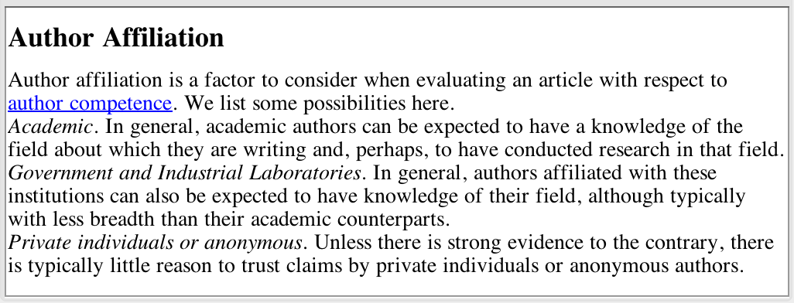
Credibility Features for Evidence

Slide 13
The Single Chain Rule (AND)

Slide 14
Module Overview
Part 1: Introducing a simple argument
Part 2: Using Google search to support the argument
Part 3: Analyzing evidence features
Part 4: Using authoritative sources to support the argument

Slide 15
Searching the Original Text

Slide 16
Book on the Internet

Slide 17
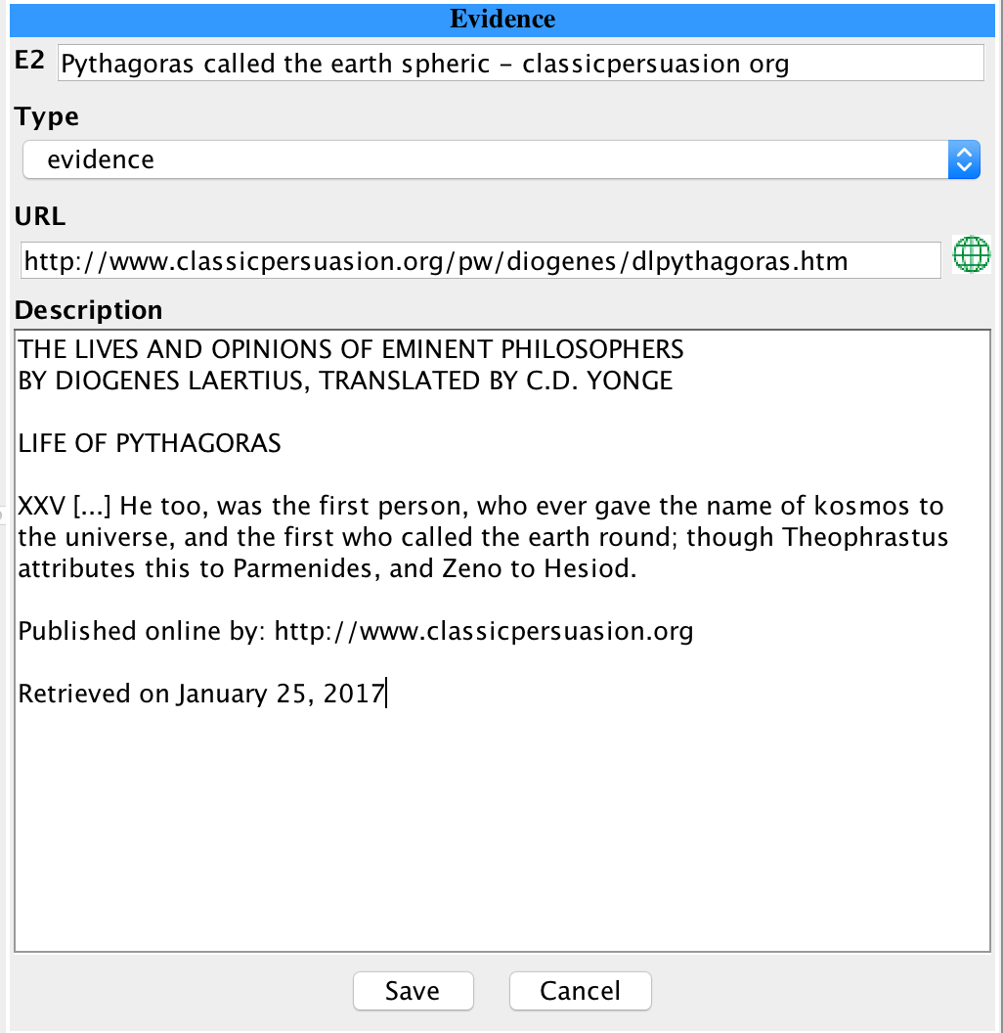
Credentials of an Internet Book

Slide 18
Module Overview
Part 1: Introducing a simple argument
Part 2: Using Google search to support the argument
Part 3: Analyzing evidence features
Part 4: Using authoritative sources to support the argument

Slide 19
The Book

Slide 20
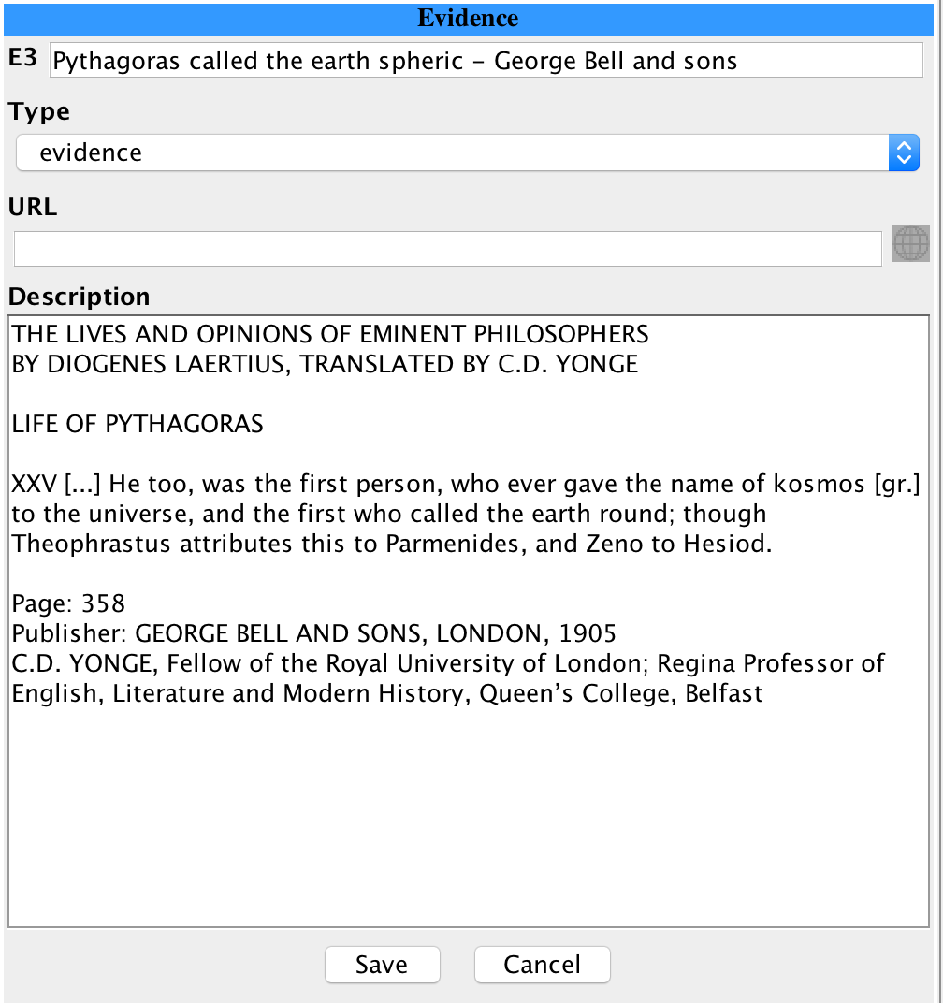
Book Analysis

Slide 21
Online Authoritative Resource

Slide 22
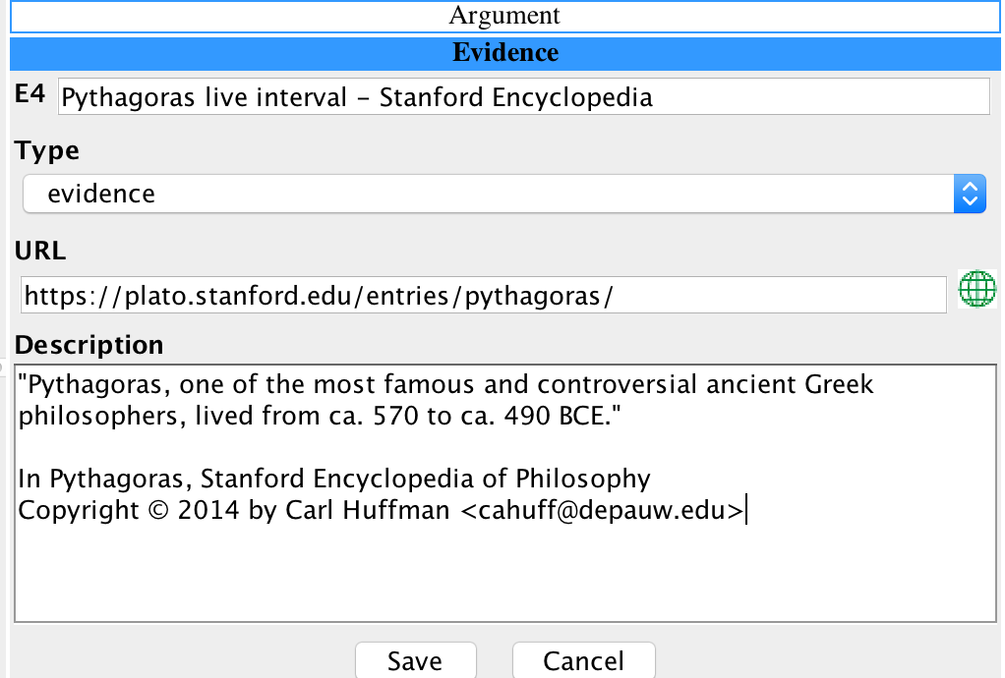
Online Authoritative Analysis

Slide 23
Overview
Presentation Goals
Lesson Objective
Module Overview
Available Lessons with Instructions

Slide 24
Available Lessons with Instructions
Inquiry: What is the wind power potential of US?
Two lessons presented various aspects related to evidence management

Slide 25
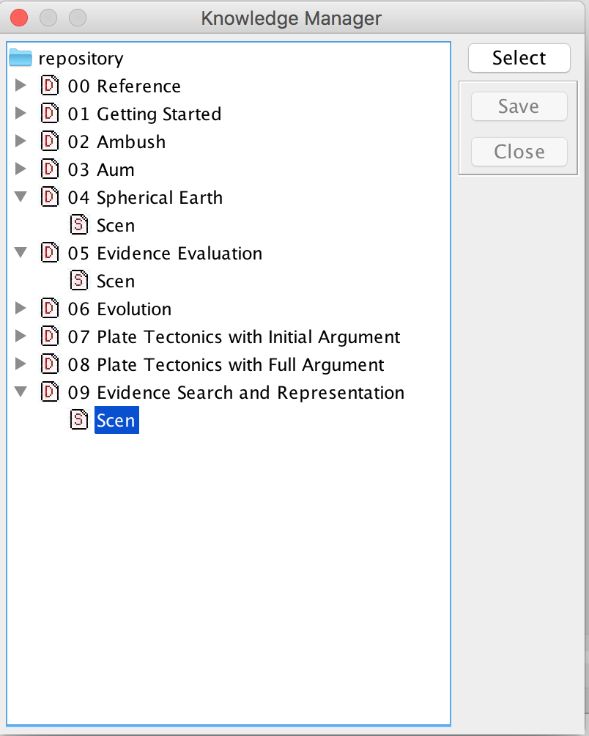
Inquiry: What is the wind power potential of US?
Knowledge Bases:
05 Evidence Evaluation
09 Evidence Search and Representation

Slide 26
Inquiry: What is the wind power potential of US?

Slide 27
Step by Step Instructions

