Slide 1
Using sInvestigator
Spring 2017 - Modern Scientific Revolutions
Class 2 – Evaluating Relevance and Credibility of Evidence
(Round Earth)
Class 3 – Evaluating Selected Evidence
(Evolution)
Class 10 – Argument Construction, Evidence Search, and Evidence Evaluation
(Plate Tectonics)
Notes:
Student engagement w/system after brief introduction during Class 1
Class 2 – Demonstration with relatable example - not course content
Classes 3 and 10 - Course content, scaffolder introduction of system features

Slide 2
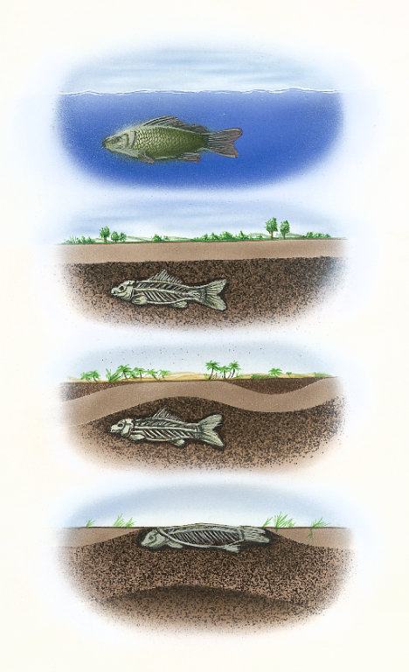
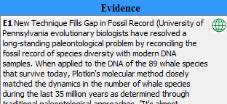
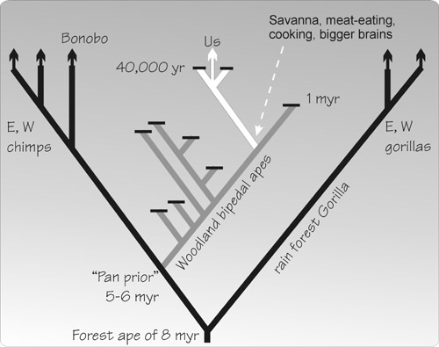
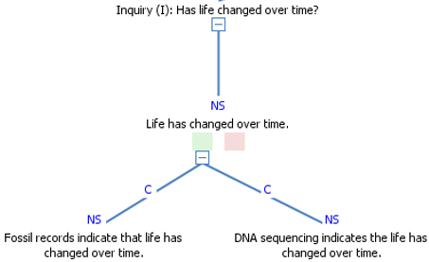
EVOLUTION Class 3 Lesson Design
What do we know? Direct Instruction | How do we know? Items of Evidence Evidence Evaluation

Slide 3
EVOLUTION sInvestigator Learning Goals
Select from 15 items of evidence
Attach items to one or more of four hypotheses
Fossil records indicate that life has changed over time.
DNA sequencing indicates that life has changed over time.
Artificial selection is possible.
There are examples of natural selection.
Evaluate item relevance and credibility
Notes:
Researcher created items – varying credibility and relevance
Relevance – What would be the probability of the hypothesis if the evidence were true?
Credibility – What is the probability that what the evidence is telling us is true?

Slide 4
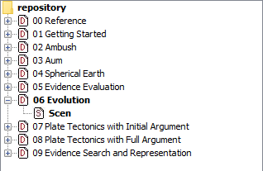
Open sInvestigator
Click on the green “+” in the corner
Select “06 Evolution”
Click on “Scen” to display initial lesson argumentation
View evidence by clicking on menu
Notes:
We are encouraging you to engage with the system as individuals, but during your work times we encourage you to collaborate with the people at your tables

Slide 5
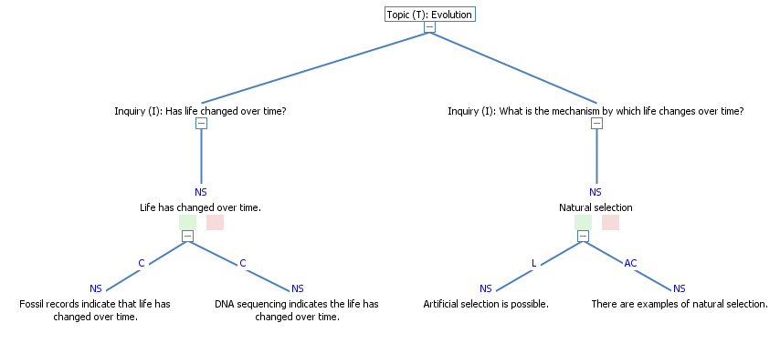
Using sInvestigator

Slide 6
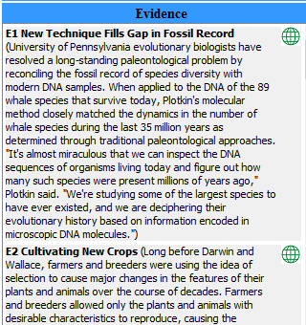
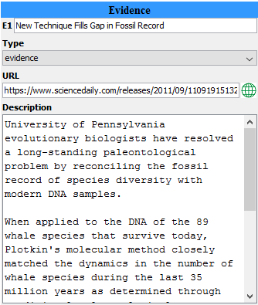
Using sInvestigator
Items of evidence in database were provided to students
double click
Notes:
Double click – repository for evidence – title, weblink and brief description or user notes

Slide 7
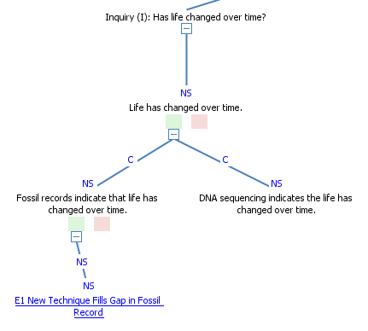
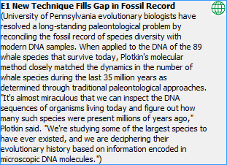
Evaluating Evidence
As you drag an item of evidence, two squares are displayed, a green one (for favoring evidence), and a red one (for disfavoring evidence).
Drop the text on the corresponding square.
The evidence is now associated with the hypothesis.
Double click on NS to assess the relevance of the evidence to the hypothesis.
Drag and drop
Drag and drop
Notes:
Item of evidence from Science Daily – work by biologists at Penn
Relevant for two of the sub-hypotheses (left side)
Drop down menu – assess the relevance of the item based on the provided description – with Internet access, you can click on the link to read the entire article

Slide 8
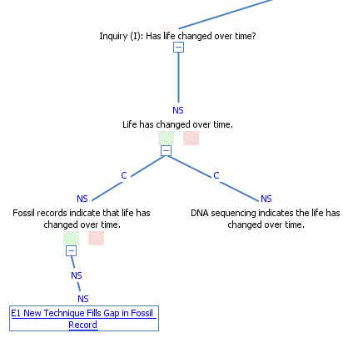
Evaluating Evidence
Assess credibility.
Click on item of evidence.
Click on Argument.
Click on [evidence].
Drag and drop [evidence] onto green box under item of evidence.
Drag and drop
Notes:
Jim provided instruction to his students about using author and publisher information in evaluating credibility. In order to prompt students consider these criteria, the sInvestigator design team built an additional feature to guide student thinking.

Slide 9
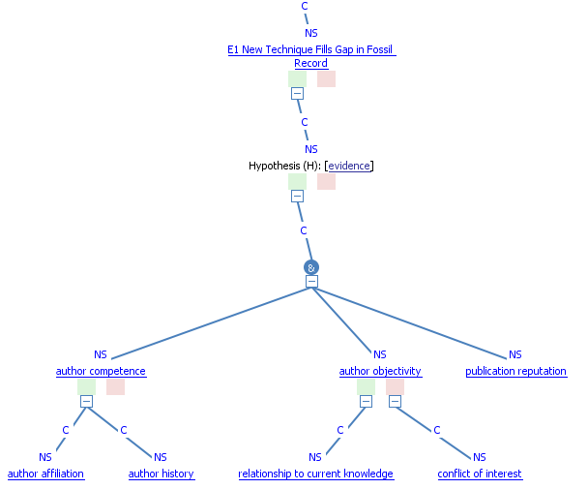
Evaluating Evidence
Double click on NS to assess the author competence, author objectivity, and publication reputation.
sInvestigator will generate a credibility rating.
Notes:
sInvestigator will use the likelihood ratings to generate a credibility rating. It is also possible to bypass lower levels of guidance and simply assign a credibility rating.

Slide 10
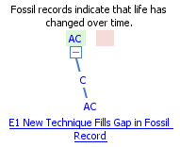
YOUR TURN Evaluate 3 items of evidence:
Drag and drop evidence to associate with relevant hypothesis.
Double click on NS to assess the relevance of the evidence to the hypothesis.
Assess credibility.
Click on item of evidence.
Click on Argument.
Click on [evidence].
Drag and drop [evidence] onto green box under item of evidence.
Evaluate author competence, author objectivity, and publication reputation.
sInvestigator will generate a credibility rating.
Relevance
Credibility
Notes:
Time – 15 minutes explanation – allow 10 minutes to engage with system

Slide 11
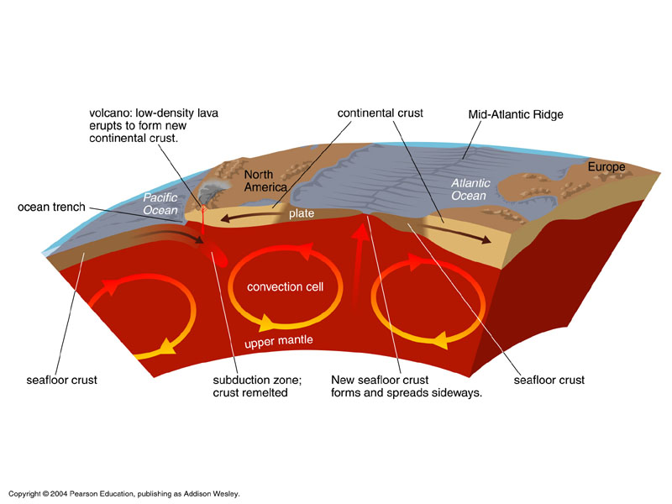
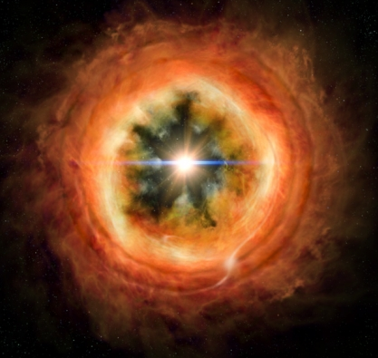
PLATE TECTONICS Class 10 Lesson Design
What do we know? Direct Instruction | How do we know? Evidence Search Evidence Evaluation
Notes:
Difference – students used Internet search to find relevant evidence

Slide 12
PLATE TECTONICS Learning Goals
Search website for potential items of evidence to support scientific inquiry
How was the Earth formed?
What drives changes in the Earth’s surface?
What are the different types of plate boundaries?
Evaluate item relevance and credibility
Notes:
15 minute lecture followed by 10 minutes with sInvestigator in collaborative groups
Focus on responding to a scientific inquiry with supporting hypotheses to build an argument

Slide 13
In sInvestigator
Click on the green “+” in the corner
Select “08 – Plate Tectonics with Full Argument”
Click on “Scen” to display argumentation
Open “sInvestigator Example Plate Tectonics Evidence” file from your flash drive.
Notes:
Collapsed version of argumentation – you will see supporting hypotheses and sub hypotheses.
Flash drive file – simulate internet search with 6 pieces of evidence, some of which were selected by the students during the class exercise.

Slide 14
Simulating Internet Search
Open “sInvestigator Example Plate Tectonics Evidence” file from your flash drive.
Highlight block of text in “Description” cell

Slide 15
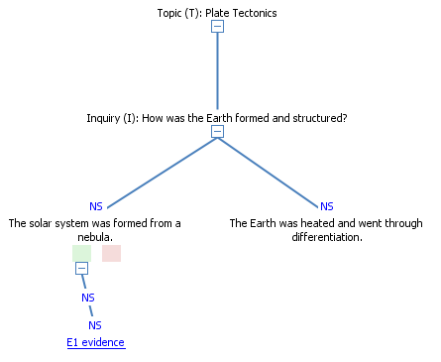
Question 1 – How was the Earth formed?
As you drag the text, two squares are displayed, a green one (for favoring evidence), and a red one (for disfavoring evidence).
Drop the text on the corresponding square.
The evidence is now associated with the hypothesis.
Drag and drop
By studying the remnant magnetizations in ancient meteorites, an MIT team has determined that the solar nebula — the vast of disc of gas and dust that ultimately gave rise to the solar system — lasted around 3 to 4 million years.
Notes:
Notice that evidence is not named

Slide 16
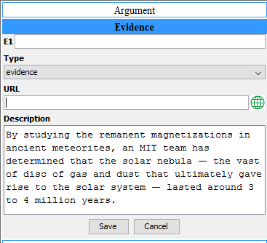
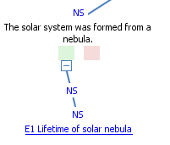
Question 1 – How was the Earth formed?
Lifetime of solar nebula
http://news.mit.edu/2017/scientists-estimate-solar-nebulas-lifetime-0209
Add a title and a URL to the evidence item.
Save edited evidence item.
Evaluate relevance and credibility.

Slide 17
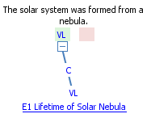
YOUR TURN Evaluate 3 items of evidence Complete justification form for 1 item
Drag and drop evidence text to associate with relevant hypothesis.
Double click on NS to assess the relevance of the evidence to the hypothesis.
Assess credibility.
Click on item of evidence.
Click on Argument.
Click on [evidence].
Drag and drop [evidence] onto green box under item of evidence.
Evaluate author competence, author objectivity, and publication reputation.
sInvestigator will generate a credibility rating.
Relevance
Credibility

