Slide 1
Research and Evaluation:
Year 1 Preliminary Findings
Teaching Critical Thinking Skills in Science with sInvestigator
Nancy Holincheck
Terrie Galanti

Slide 2
Over-arching Evaluation Question
Is it working?
Is sInvestigator effective in helping students learn critical thinking skills?

Slide 3
Sequence of our project
Fall 16
Spring 17
Sum 17
Fall 17
Spring 18
Sum 18
Fall 18
Spring 19
Sum 19
Development of Successive Versions of sInvestigator
Development of Knowledge Bases and Practice Exercises
Experimentation
Evaluations
Exploration and Dissemination Workshops
W
W
W
Annual Reports
R
R
R
10/1/16
01/10/17
05/25/17
08/25/17
01/01/18
05/25/18
08/25/18
01/01/19
05/25/19
9/30/19

Slide 4
Year 1 Research Questions:
How do students use sInvestigator as they identify and evaluate relevant evidence for a given hypothesis? In what ways do students evaluate academic sources differently after using sInvestigator?
Are students learning content in an inquiry setting?
What are the benefits and challenges of using sInvestigator as an instructional strategy in a science course for non-science majors?

Slide 5
Measures
Year 1, Semester 1 measures include:
Scientific Epistemological Views (SEV) Scale*
Pre & post measures of content knowledge
Observations of students during classes
Student “exit tickets”
Group audio recordings & video recordings of class
Pre & post measure: Evaluation of Scientific Evidence https://www.surveymonkey.com/r/sinvworkshop
*Tsai, C. C., & Liu, S. Y. (2005). Developing a multi‐dimensional instrument for assessing students’ epistemological views toward science. International Journal of Science Education, 27(13), 1621-1638.

Slide 6
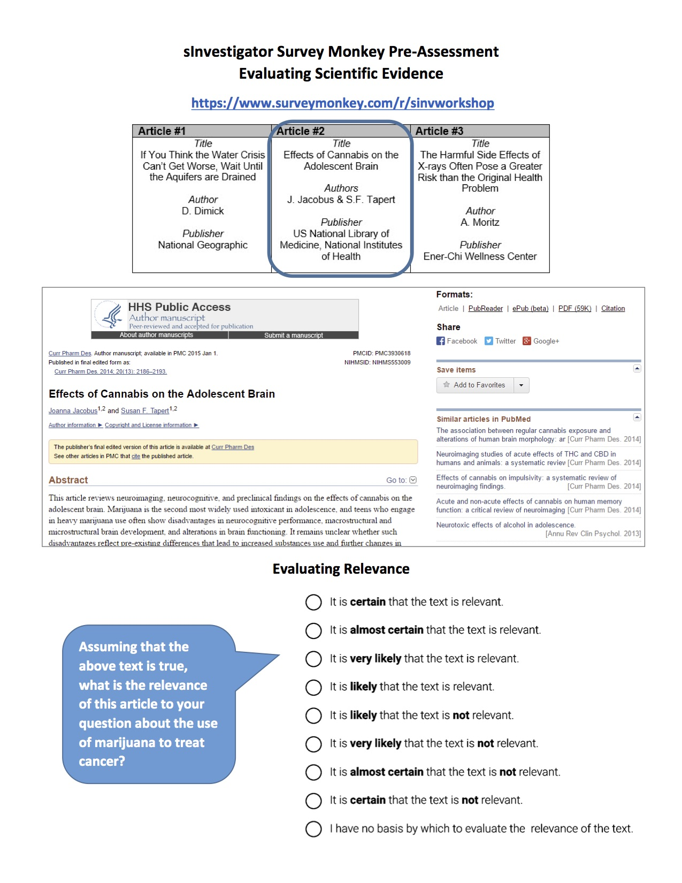
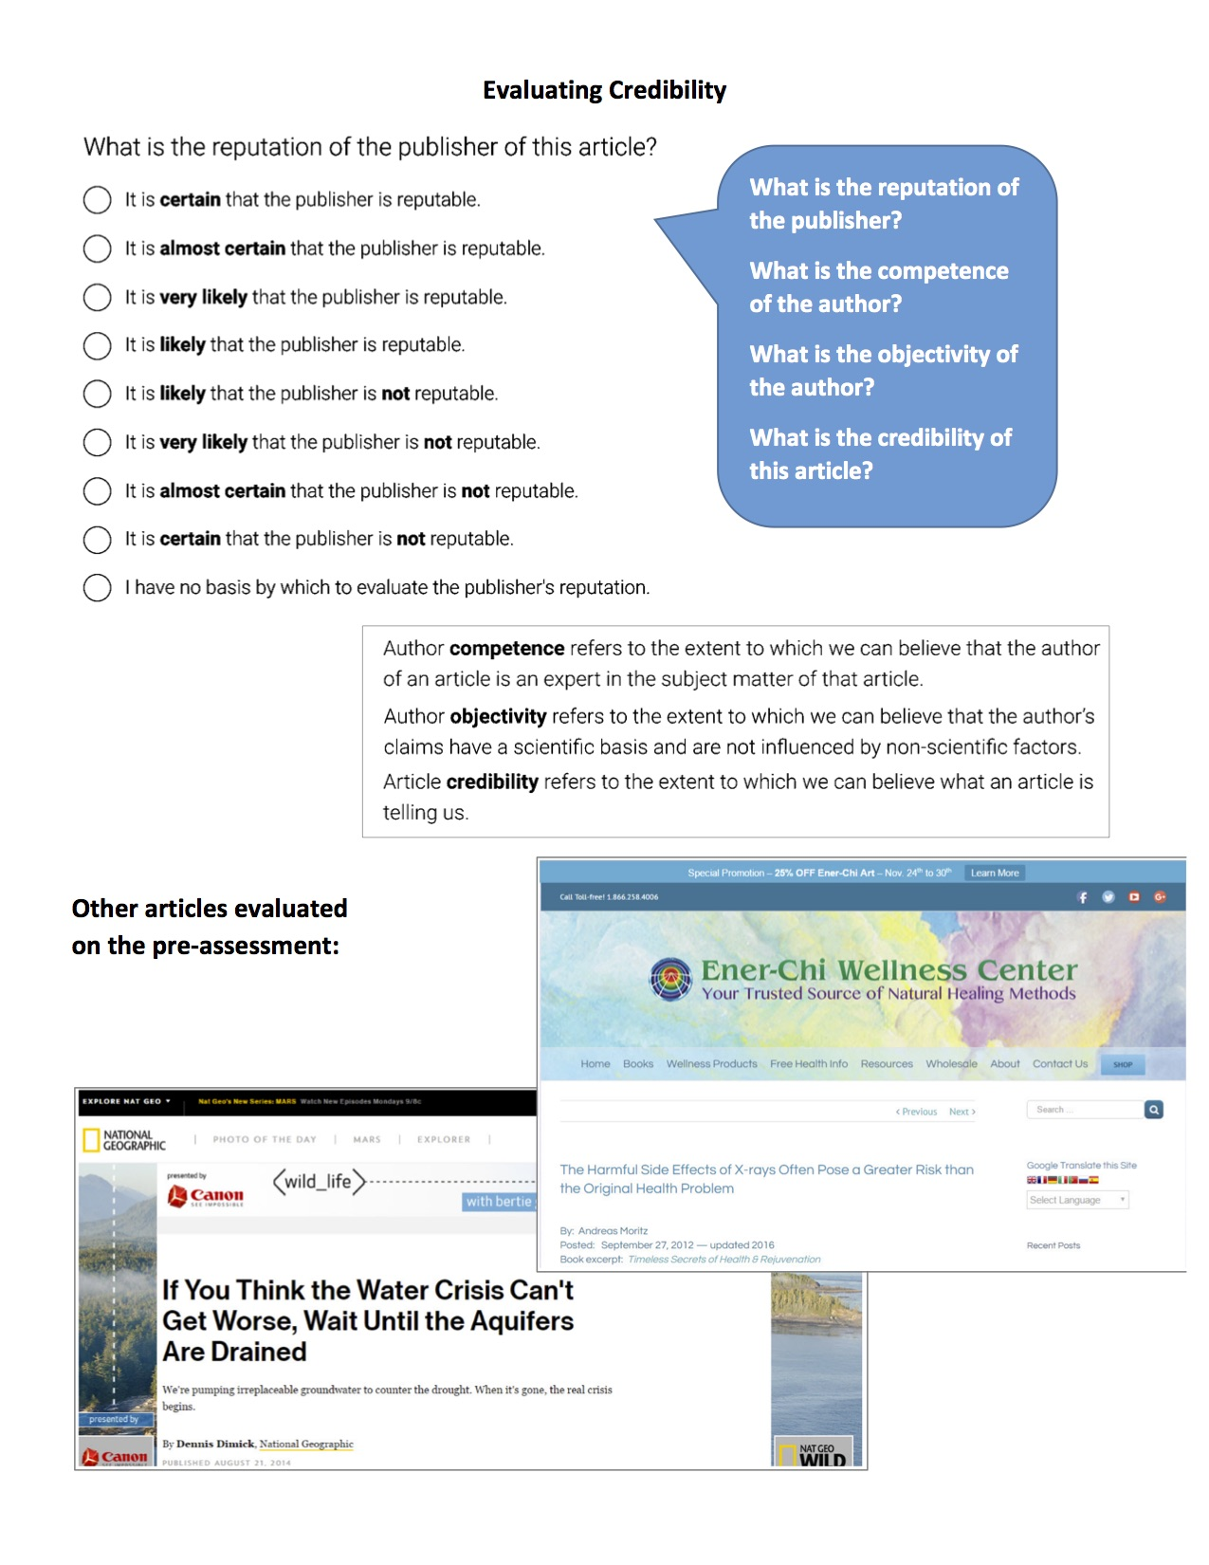
Evaluation of Scientific Evidence
This measure was developed by the team for use throughout the project
Measures student skill in evaluating the relevance and credibility of scientific evidence
Students took this at the beginning & end of semester
https://www.surveymonkey.com/r/sinvworkshop

Slide 7
Preliminary findings: Student evaluation of sources
Focus on Peer-reviewed academic journals:
What is the reputation of the publisher of this article?
Percentage of students rating “It is certain that the publisher is reputable” increased from 41% to 63%
What is the credibility of this article?
Percentage of students rating “It is certain that the article is credible” increased from 31% to 48%
Conclusion: After using sInvestigator as part of a college science course, more students were able to identify peer-reviewed academic sources as certainly reputable and certainly credible.

Slide 8
Content measure
Students’ scores increased on the content measure, but these gains were not statistically significant. (Pre M=4.65, SD=2.01; post M=5.00, SD=1.88), t(22)=-.819, p=.421.
Conclusions:
Items on content measure must be clearly aligned with the evidence students will examine
A challenge with teaching in an inquiry-based classroom is that students may learn content that isn’t on the content measure

Slide 9
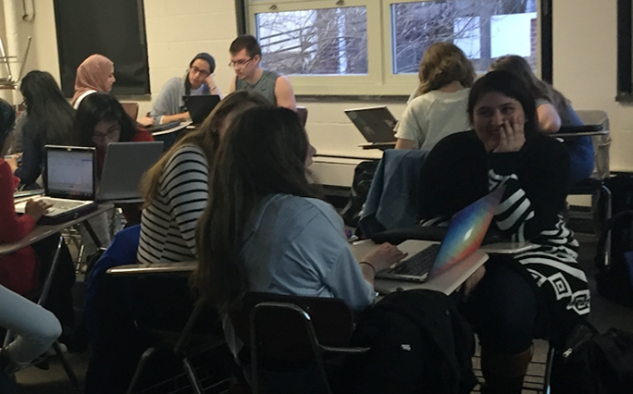
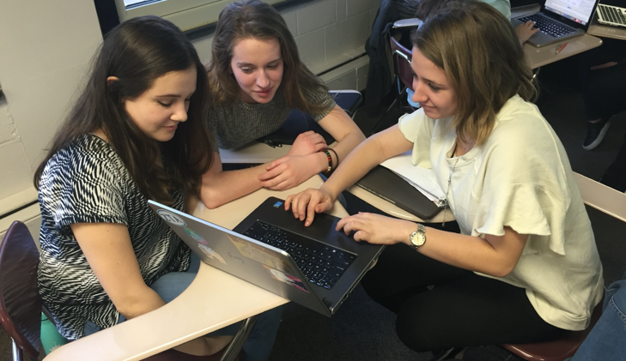
Preliminary qualitative findings
Use of sInvestigator in small groups promoted collaborative conversations and debate
Students were engaged in discussion about science content while working in groups.
Although some time was spent off task, while using sInvestigator students regularly returned to discussion of content

Slide 10
Additional findings
Students are tech-savvy and require purposeful scaffolding rather than direct step-by-step instruction
“They were surprisingly good at picking up the different operations of the the tools” - Graduate Assistant
The software scaffolds and supports student thinking. Students relied on the sInvestigator guide that was added to the system to support evaluation of credibility of an article
This new feature of sInvestigator was added to support the lesson introducing Evidence Evaluation, but students continued to use it throughout the semester

Slide 11
Conclusions & Implications for Y2
The software team added important functionality to the sInvestigator tool during year 1, especially the Evidence Features Evaluation assistant. Additional refinement of the tool will continue.
Although quantitative results are limited, they are promising. During year 2 further refinement of research plan will include
Development of content measures aligned with evidence provided to students in sInvestigator
Examination of the student evidence and argument trees submitted during classwork
Student interviews

